Slide 1
Making Complex Decisions
1

Slide 2
Sequential Decisions
Agent’s utility depends on a sequence of decisions
Also known as accessible, deterministic domains
▪
▪
▪
▪
▪
Utilities,
Uncertainty, Sensing Generalize search
Planning problems.

Slide 3

Simple Robot Navigation Problem
2
In each state, the possible actions are U, D, R, and L

Slide 4
Probabilistic Transition Model
In each state, the possible actions are U, D, R, and L
The effect of U is as follows (transition model):
  With probability 0.8 the robot moves up one square

Slide 5
4

Slide 6
Probabilistic Transition Model
In each state, the possible actions are U, D, R, and L
The effect of U is as follows (transition model):
  With probability 0.8 the robot moves up one square
  With probability 0.1 the robot moves right one square
  With probability 0.1 the robot moves left one square.
5

Slide 7
Markov Property
❖
The transition properties depend only on the current state, not on previous history (how that state was reached)
6

Slide 8
Markov Decision Process (MDP)
Defined as a tuple: <S, A, M, R>
  S: State
  A: Action
  M: Transition function
  R: Reward
Choose a sequence of actions
- Utility based on a sequence of decisions
7

Slide 9
Generalization
▪
Inputs:
Initial state s0
Action model
Reward R(si) collected in each state si
▪
▪
A state is terminal if it has no successor
Starting at s0, the agent keeps executing actions until it reaches a terminal state
Its goal is to maximize the expected sum of rewards collected (additive rewards)
▪
▪
▪
Additive rewards: U(s0, s1, s2, …) = R(s0) + R(s1) + R(s2)+ …
Discounted rewards
U(s0, s1, s2, …) = R(s0) + γR(s1) + γ ²R(s2) + …(0 < γ ≤ 1)
8

Slide 10
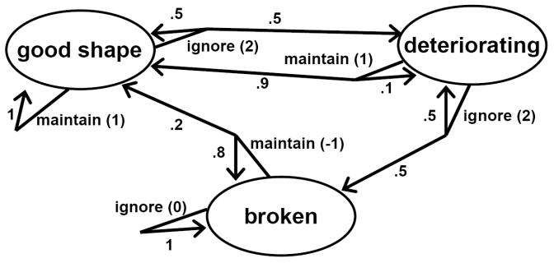
Example MDP
Machine can be in one of three states: good, deteriorating, broken
Can take two actions: maintain, ignore

Slide 11
Policies
To know what state have reached (accessible)
Calculate best action for each state
- Always know what to do next!
Mapping from states to actions is called a policy
10

Slide 12
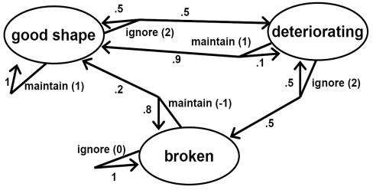
Policies
No time period is different from the others
Optimal thing to do in state s should not depend on time period
  … because of infinite horizon
  With finite horizon, don’t want to maintain machine in last period
A policy is a function π from states to actions
Example policy: π(good shape) = ignore, π(deteriorating) = ignore,

Slide 13
π(broken) = maintain
11

Slide 14
Evaluating a policy
Key observation:
MDP + policy = Markov process with rewards
To evaluate Markov process with rewards: system of linear equations
Gives algorithm for finding optimal policy: try every possible policy, evaluate
– Terribly inefficient

Slide 15
Bellman equation
Suppose state s, and play optimally from there on
This leads to expected value v*(s)
Bellman equation:
v*(s) = maxa R(s, a) + δΣsꞌ P(s, a, sꞌ) v*(sꞌ)
Given v*, finding optimal policy is easy

Slide 16
Value iteration
Calculate utility of each state U (state)
Use state utilities to select optimal action
14

Slide 17
Value iteration algorithm for finding optimal policy
▪
Start with arbitrary utility values
▪
Update to make them locally consistent with bellman eqn.
▪
Repeat until “no change”
15

Slide 18
Policy iteration algorithm for finding optimal policy
Easy to compute values given a policy
– No max operator
Policies may not be highly sensitive to exact utility values ⇒ May be less work to iterate through policies than utilities
16

Slide 19
Policy Iteration Algorithm
π ← an arbitrary initial policy repeat until no change in π compute utilities given π (value determination) Update π
as if utilities were correct (i.e., local MEU)
17
18

